Slide 1
git
Session 01 - Basics of git

Slide 2
Index
Intro
Basic theory concepts
Basic practical concepts

Slide 3
Intro
What is git?
Who created git?
Why is git used for?
Basics of git

Slide 4

What is git?
Version control system

Slide 5

Who created git?
Open source project originally developed in 2005 by Linus Torvalds
Most programmers do programming not because they expect to get paid or get adulation in public, but because it is fun to program.

Slide 6
Why is git used for?
github.com/
torvalds/linux - [Linux kernel]
charliewolf/pynder - [Python client for Tinder]
lesspass/lesspass - [Passwd manager]
bitcoinbook/bitcoinbook - [Bitcoinbook]
enaqx/awesome-pentest - [Pentest resources]
codepath/android_guides - [Android guides]
atom/atom - [Atom IDE]
Version control
Server (git server)
Repository
Remote file storage
Shared file system

Slide 7
Basic theory concepts
Crossplatform
git vs other methods
Console vs App
Github & Bitbucket
Basics of git

Slide 8





Slide 9

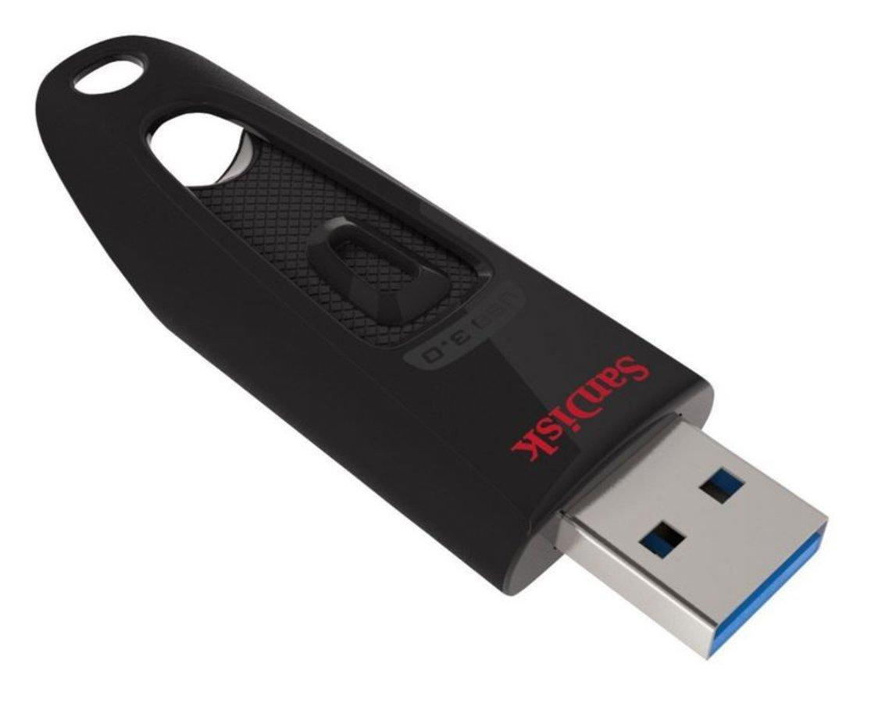

VS
ftp

Slide 10




VS

Slide 11


github.com
bitbucket.org

Slide 12
Basic practical concepts
What is a repo?
Creating a repo
Cloning a repo
My first commit
Local or Server?
Extras & References
Basics of git

Slide 13
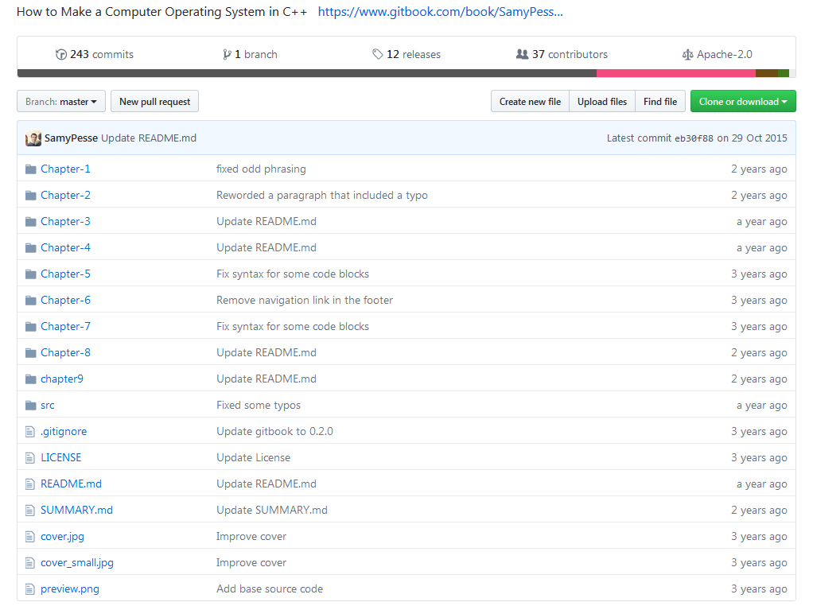
Repo?
Local/Online?
SamyPesse/How-to-Make-a-Computer-Operating-System

Slide 14
Creating a repo
Server (GitHub.com)
Local (GitKraken)
Local (git init)
Basics of git

Slide 15
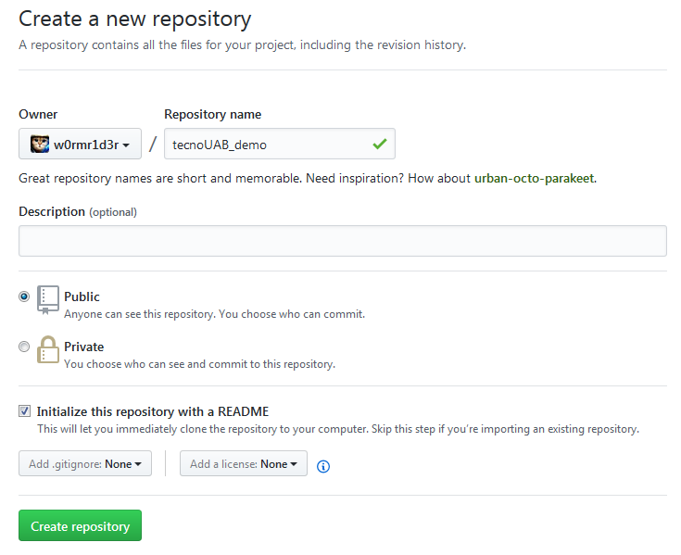

Slide 16
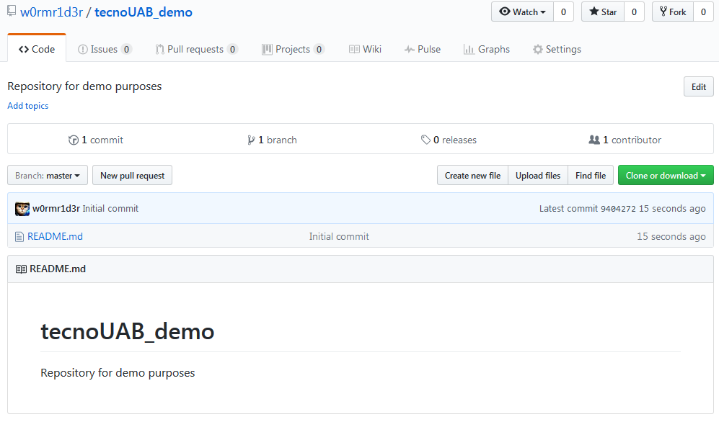

Slide 17
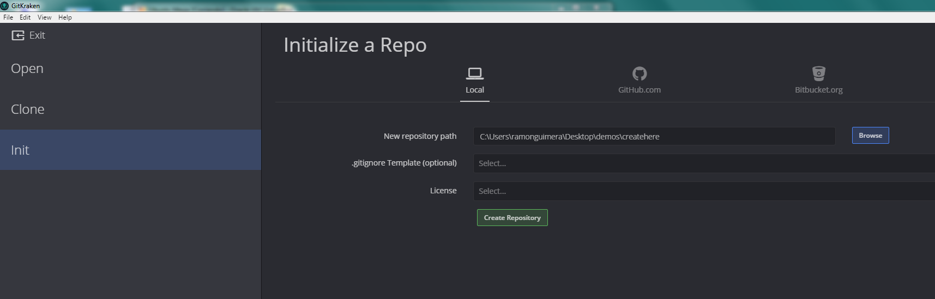
File Init Repo (ctrl+i)

Slide 18
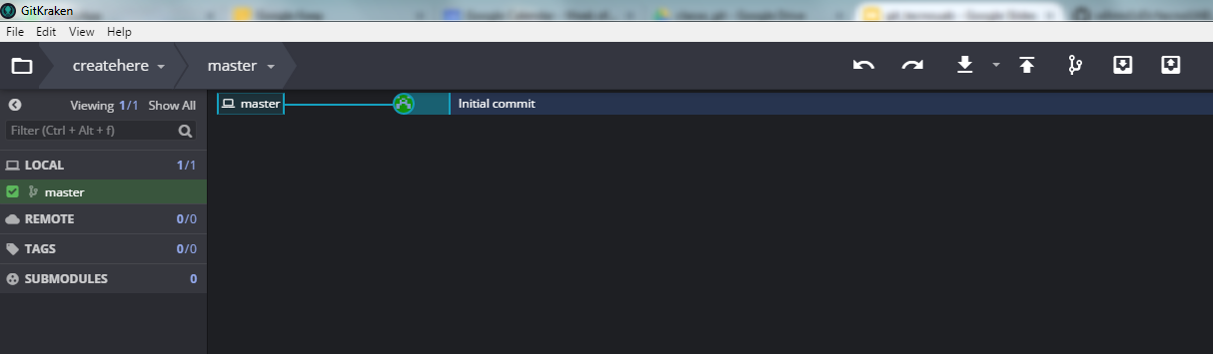
DONE !

Slide 19
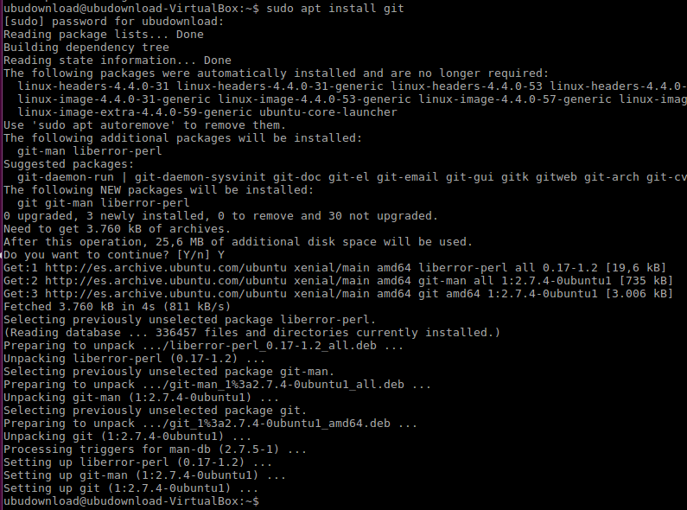
Option 2
sudo apt install git -y

Slide 20
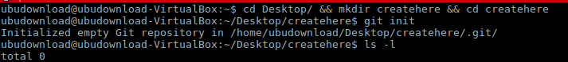
DONE !
Option 2
cd Desktop/ && mkdir createhere && cd createhere && git init

Slide 21
Cloning a repo
App (GitKraken)
Console (git clone)
Basics of git

Slide 22
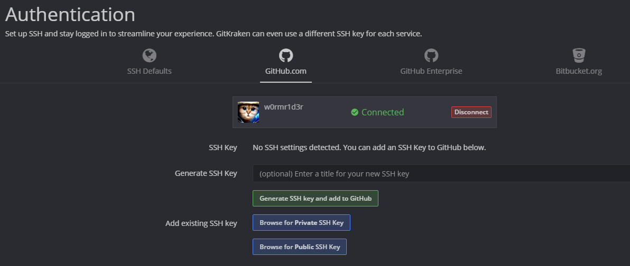
Step 1: Authentication

Slide 23
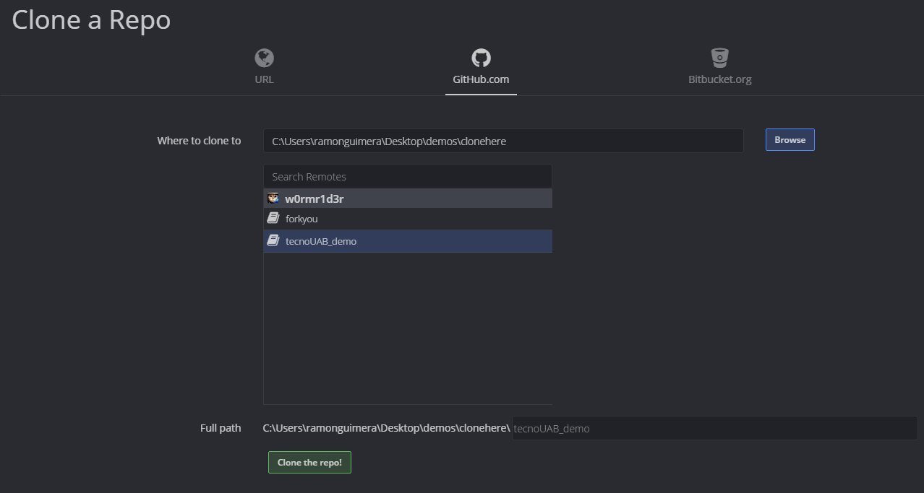
Step 2: Select repo + path

Slide 24
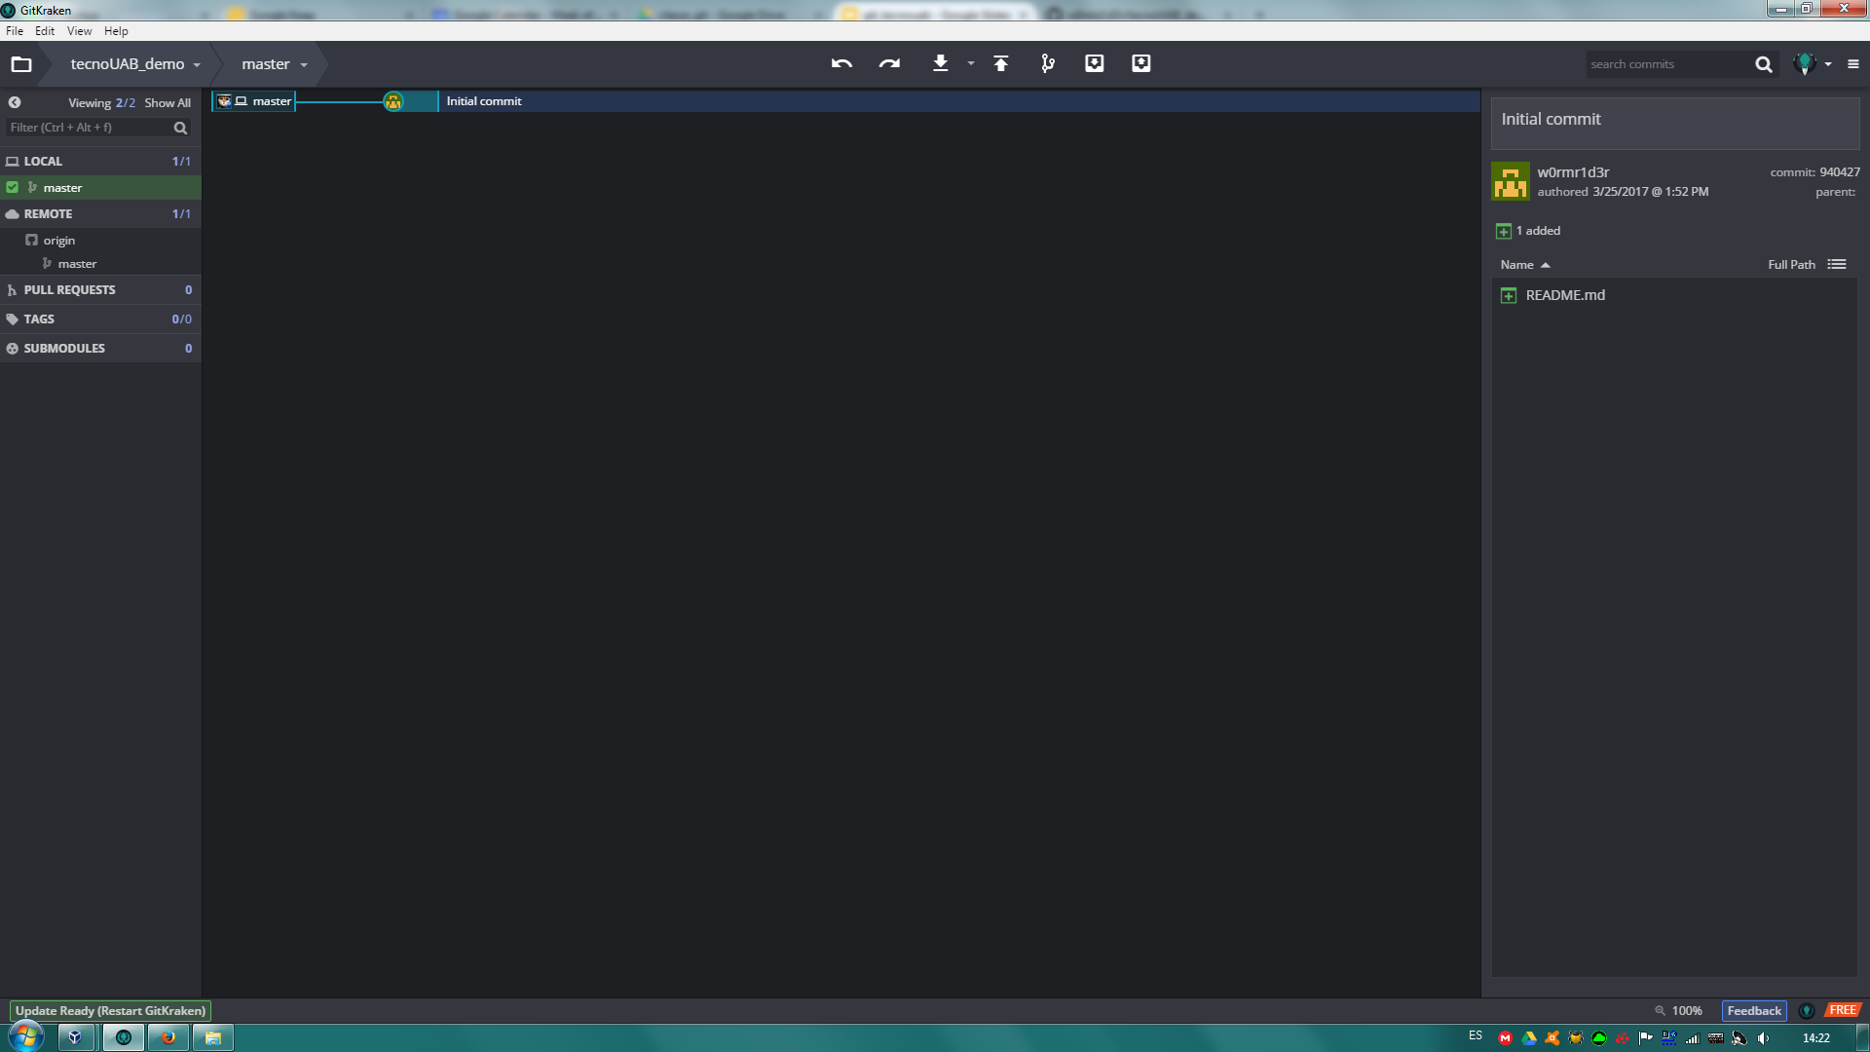
Step 3: Spot the differences
Advanced git

Slide 25
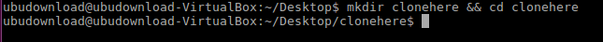
Step 1: mkdir

Slide 26
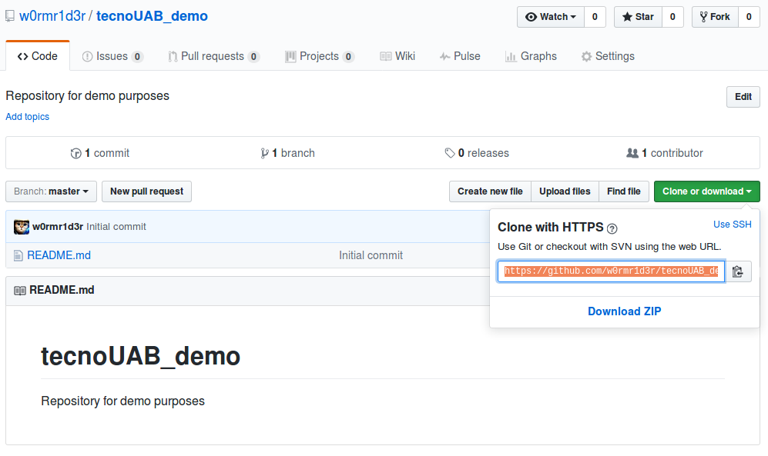
Step 2: URL + repo.git

Slide 27
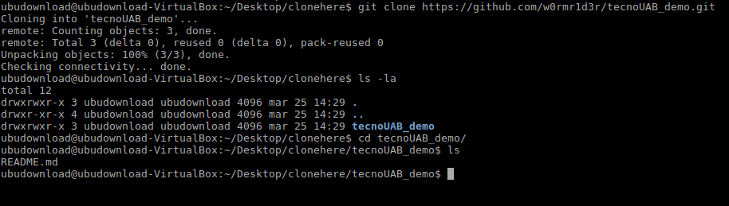
Step 3: Clone (g)it

Slide 28
First Commit
Pull
Stage
Commit
Push
Conflict!
Basics of git

Slide 29
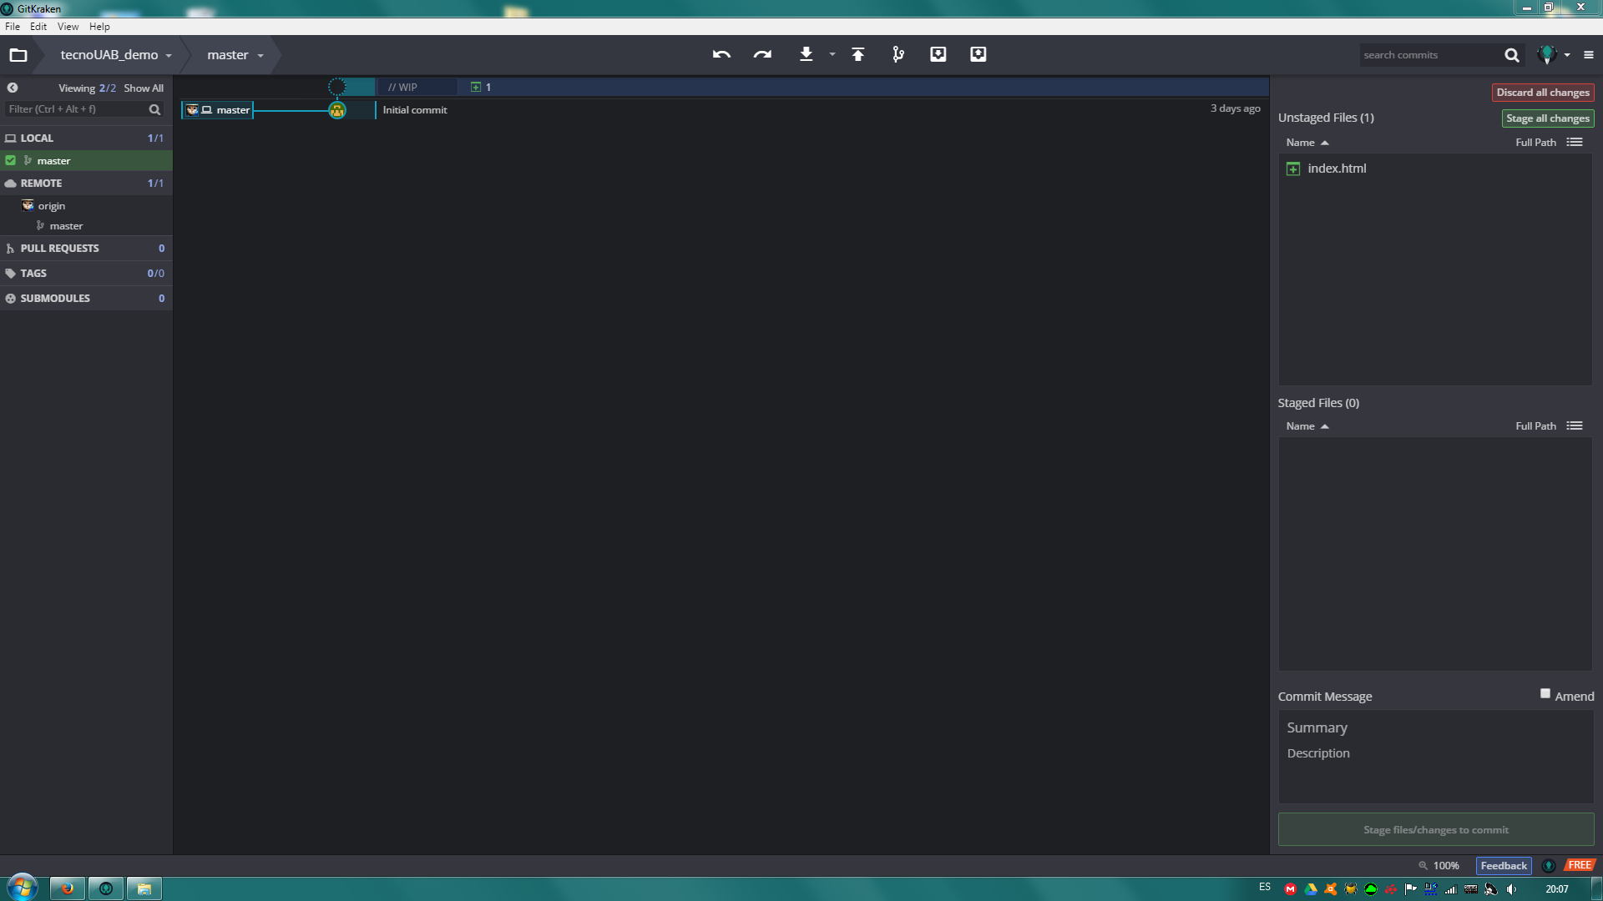
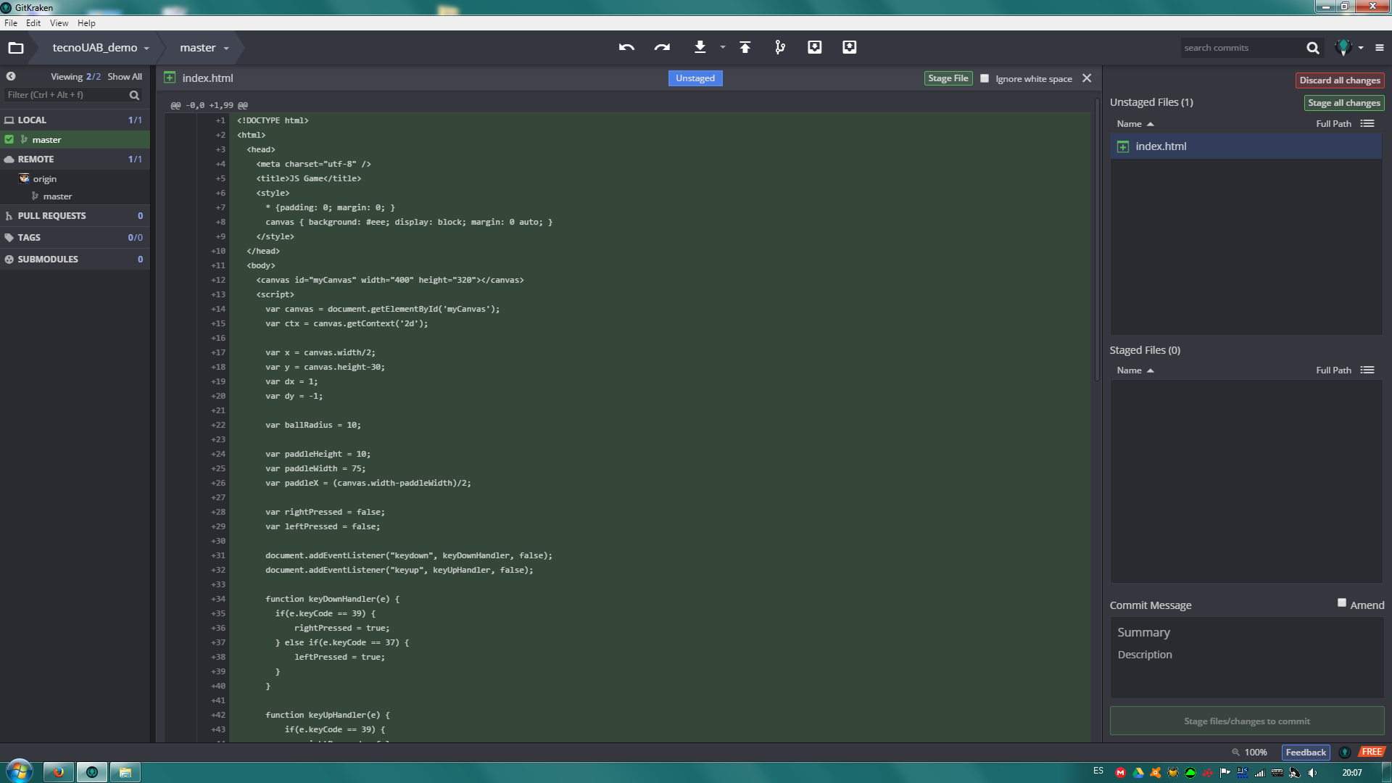
Pull + edit files

Slide 30
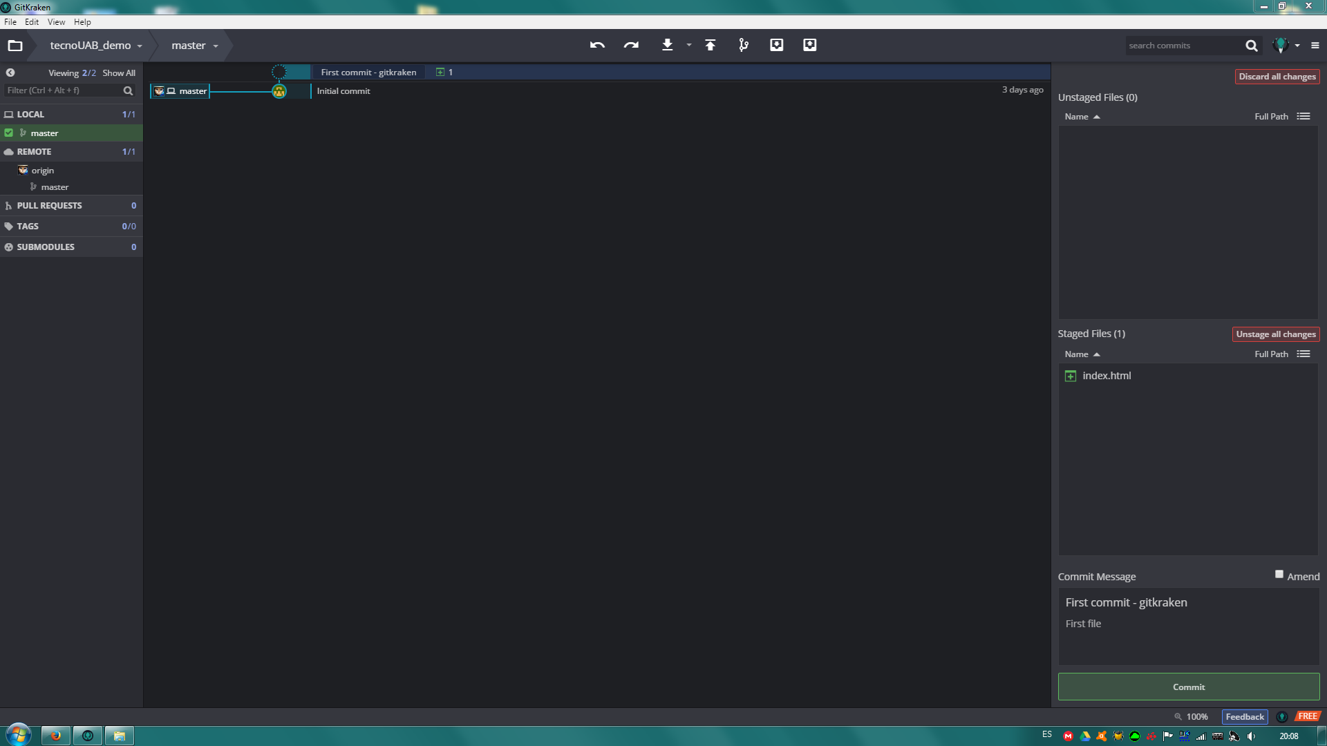
2) Stage

Slide 31
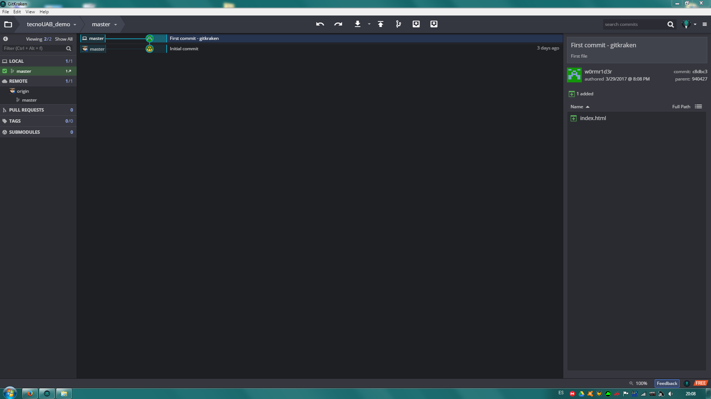
3) Commit

Slide 32

4) Push

Slide 33
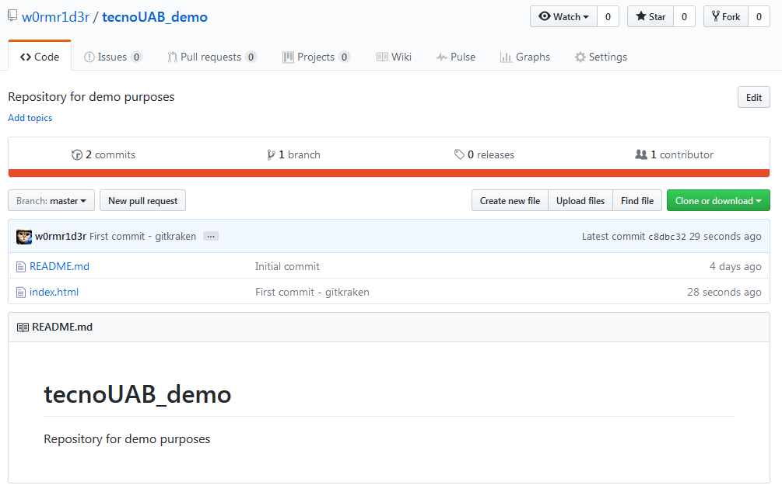
5) Result = no conflict this time
Look at this!

Slide 34
And, if I’m using Linux?

Slide 35
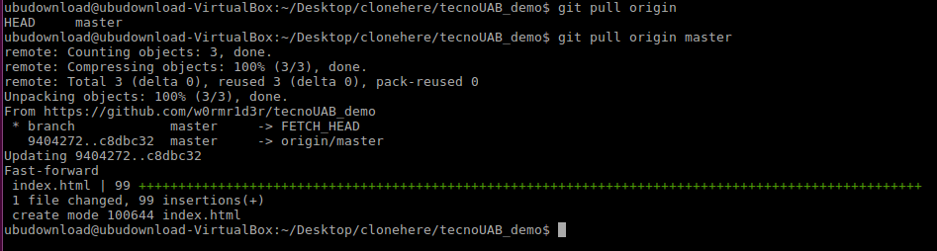
1) Pull !!!

Slide 36
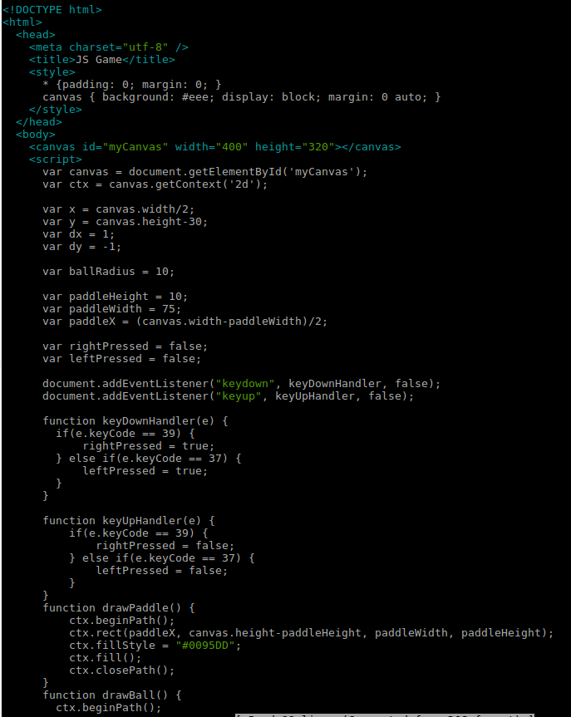
2) See? The file is here as well!
Edit it!

Slide 37
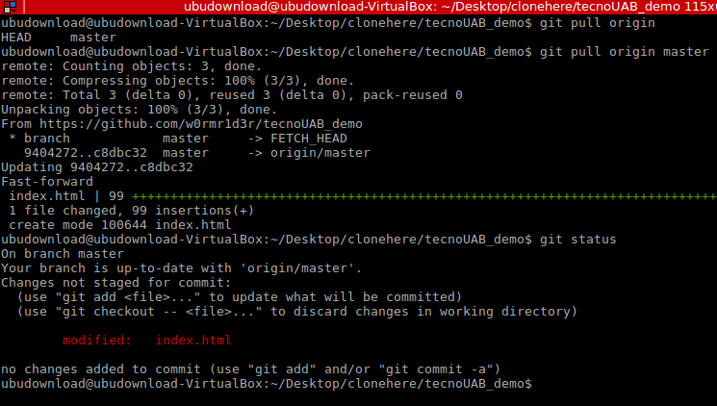
3) git status (Stage)

Slide 38
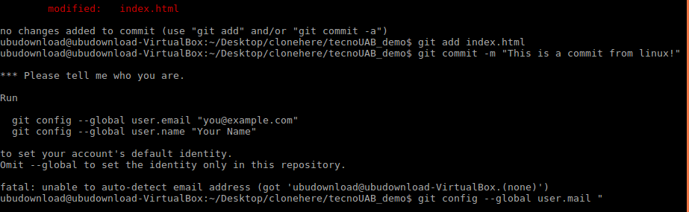
3) git add . && git commit -m “Message”

Slide 39
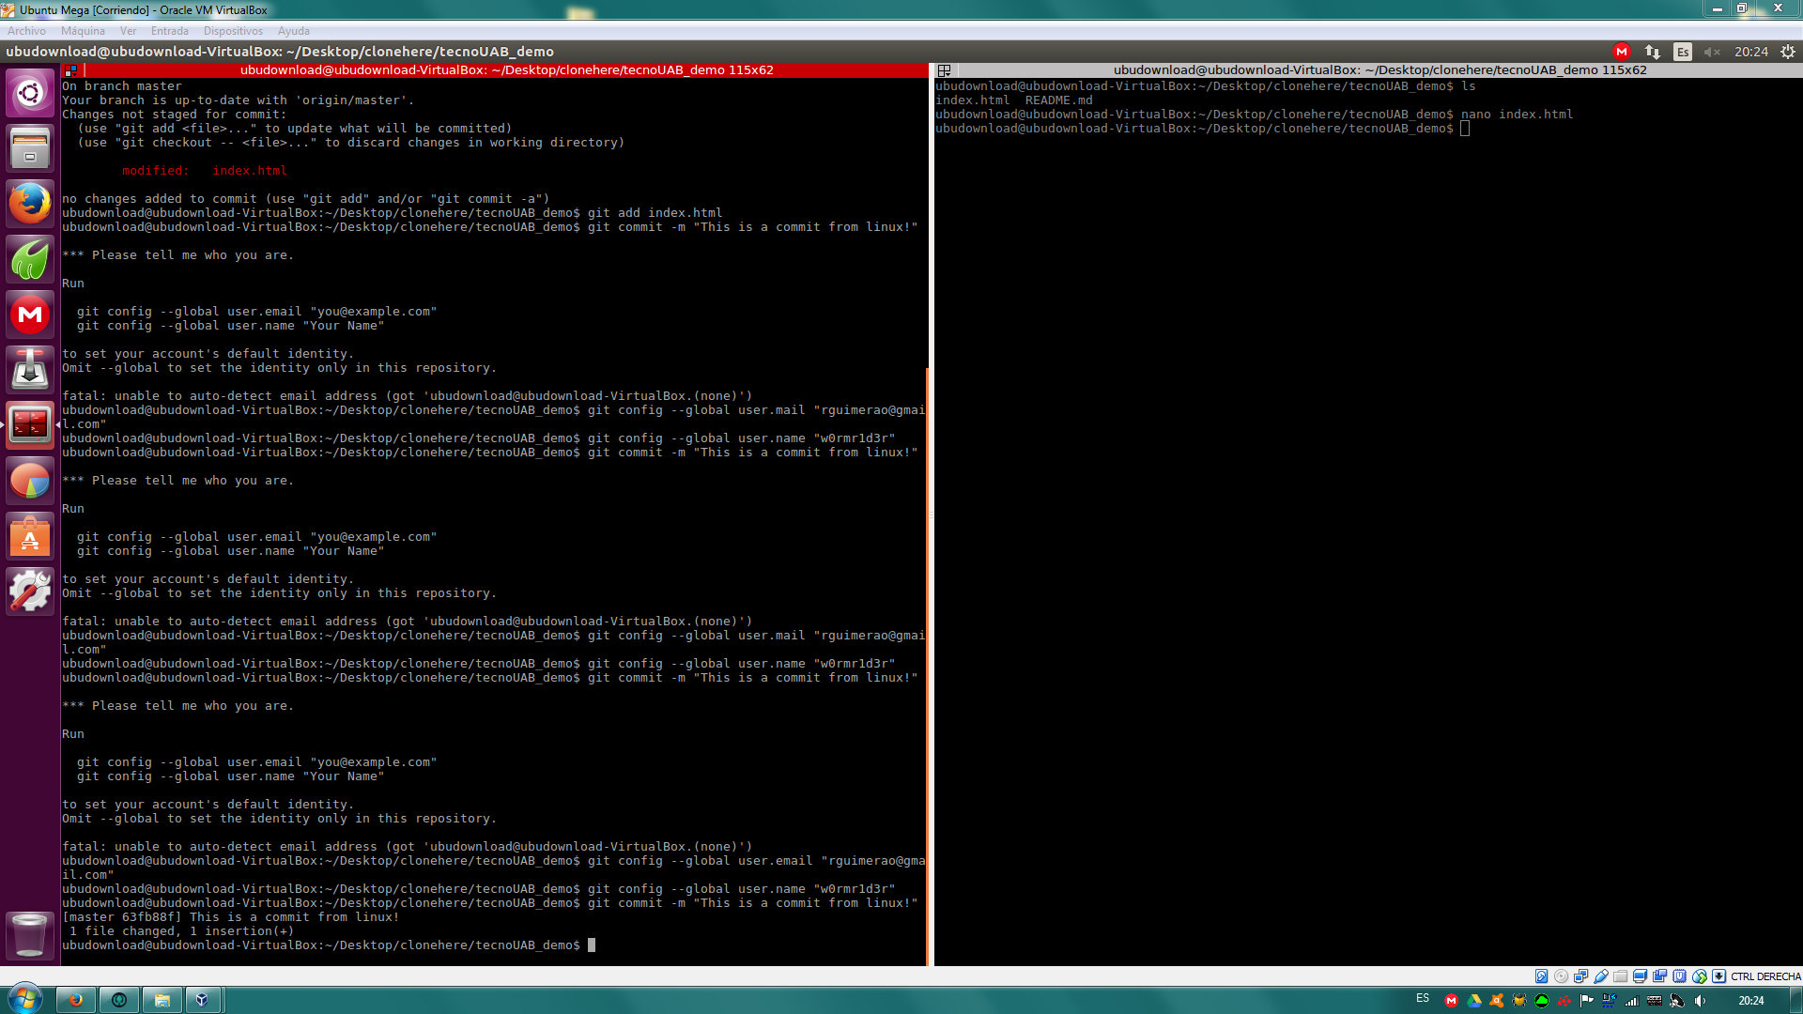
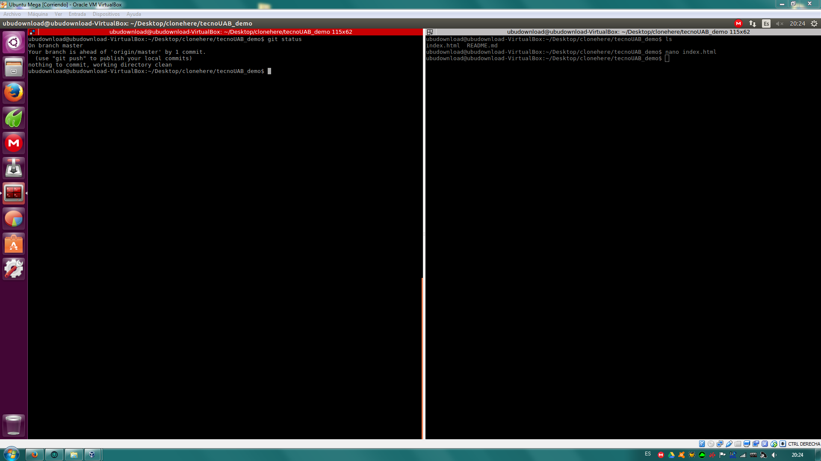
3) Check if everything is fine (git status)

Slide 40
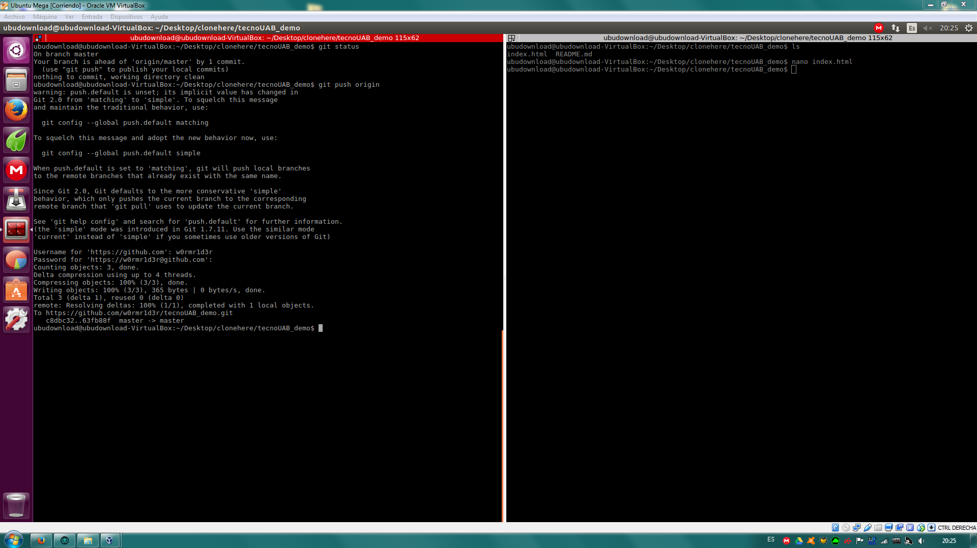
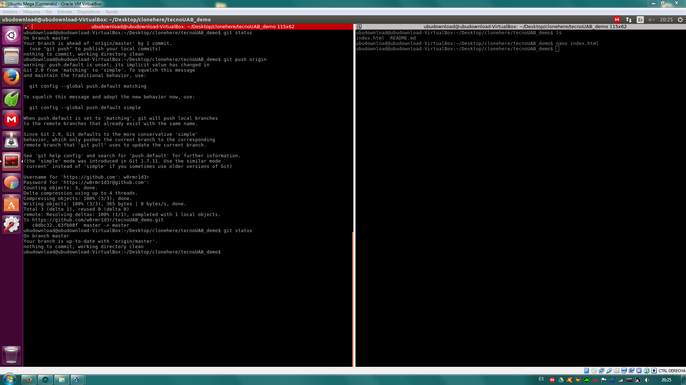
4) Push it !!!

Slide 41
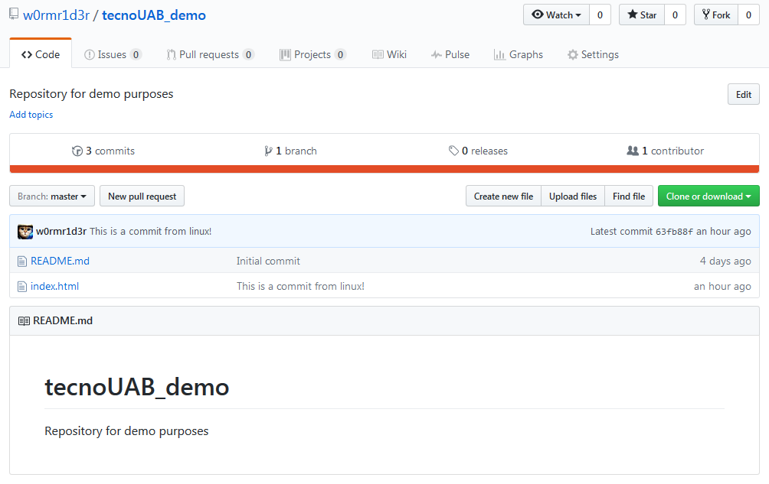
Online Result

Slide 42
Extras and References
github.com/w0rmr1d3r/tecnoUAB_demo

Slide 43
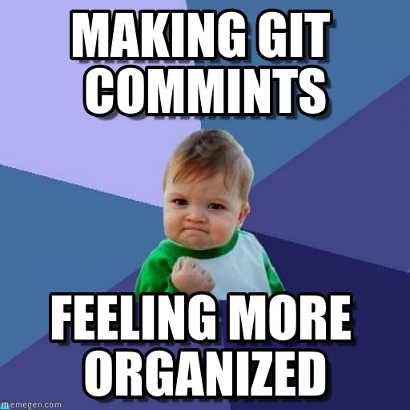
Extras
sudo apt-get install terminator
enki.com
codecademy.com/learn/learn-git
youtube.com/watch?v=4XpnKHJAok8

Slide 44
References
en.wikipedia.org/wiki/Git
www.atlassian.com/git/tutorials/what-is-git

